Slide 1
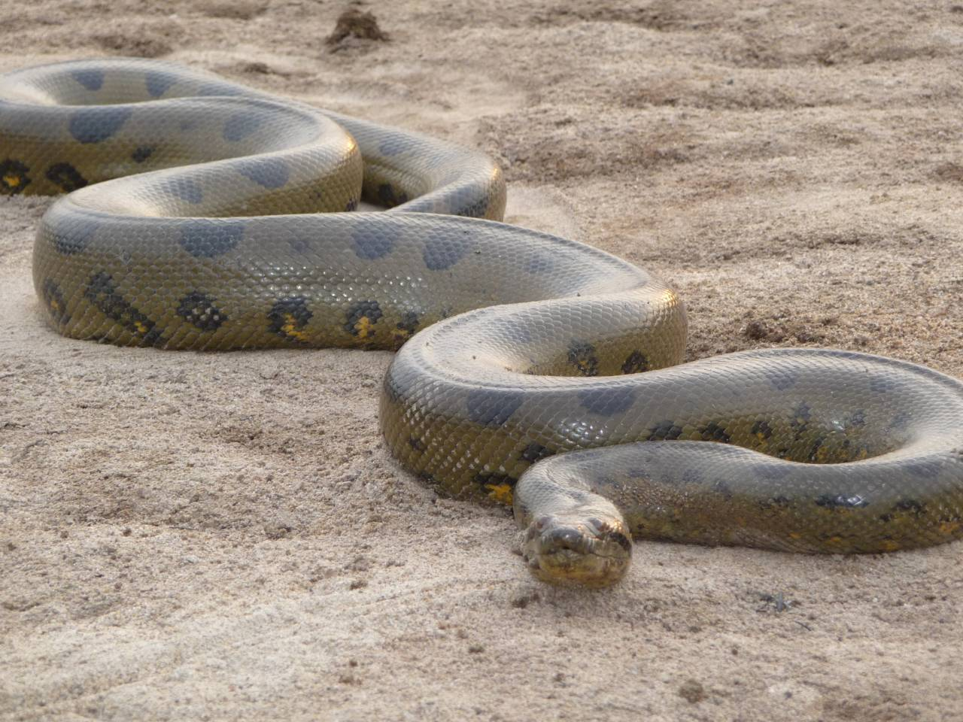
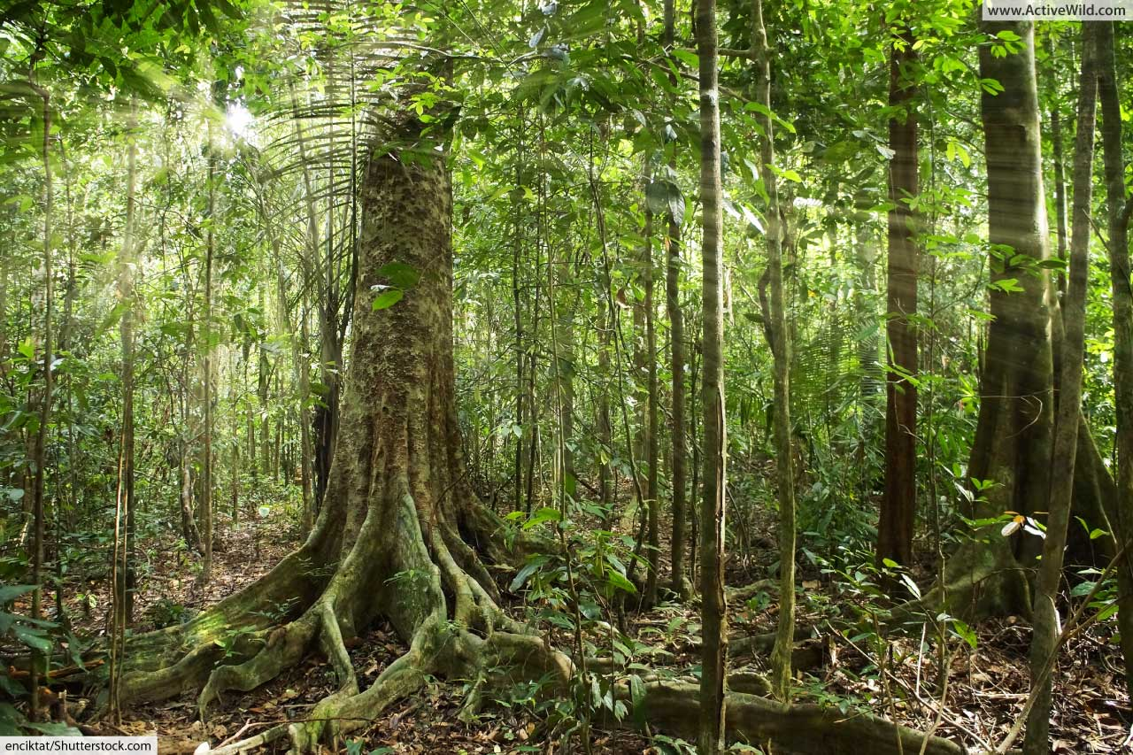
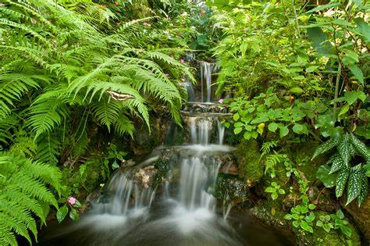
Animals of the Rainforest
Green Anacondas
By Finn Dyer P7

Slide 2
Facts About Green Anacondas
The Green anaconda is the largest species of snake on planet earth, can weigh up to 550 pounds and its life span is up to 10 years.
The anaconda is one of the deadliest snakes in the world, it kills its prey by suffocation. It wraps it's body around it's prey tighter and tighter, until it's prey can no longer breath, then swallows it's prey whole!
Anacondas are carnivores, which means they only eat meat and not plants. Their main food source is usually other animals like large fish, pigs, goats and even crocodiles. There have also been reports of anacondas attacking and eating humans!
The green anacondas are only found in South America in the tropical swamps and rainforests. They live both on land and in the water.
Unlike most snake species, green anacondas do not lay eggs. When they breed baby snakes the babies are born live.

Slide 3
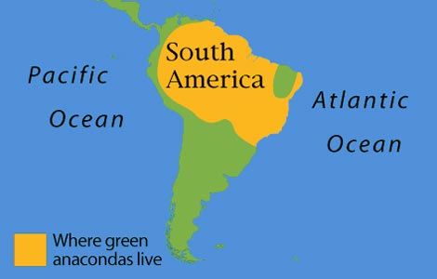
Anacondas are found in the South American rainforests only, mostly in Brazil, Colombia and Bolivia

Slide 4
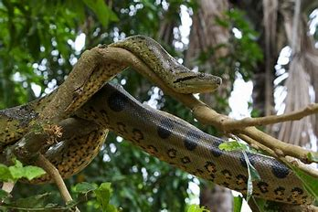
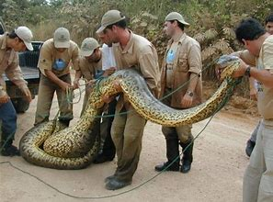
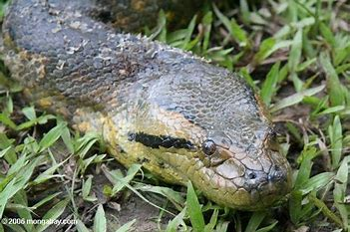
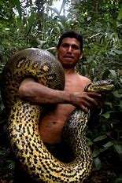
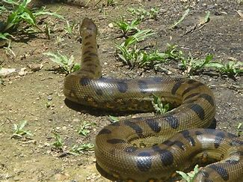
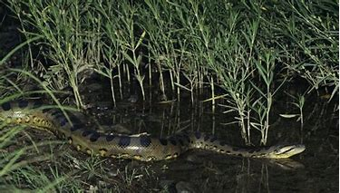
Thank You.... here are some really cool pictures of green anacondas in the rainforest!

