Slide 1
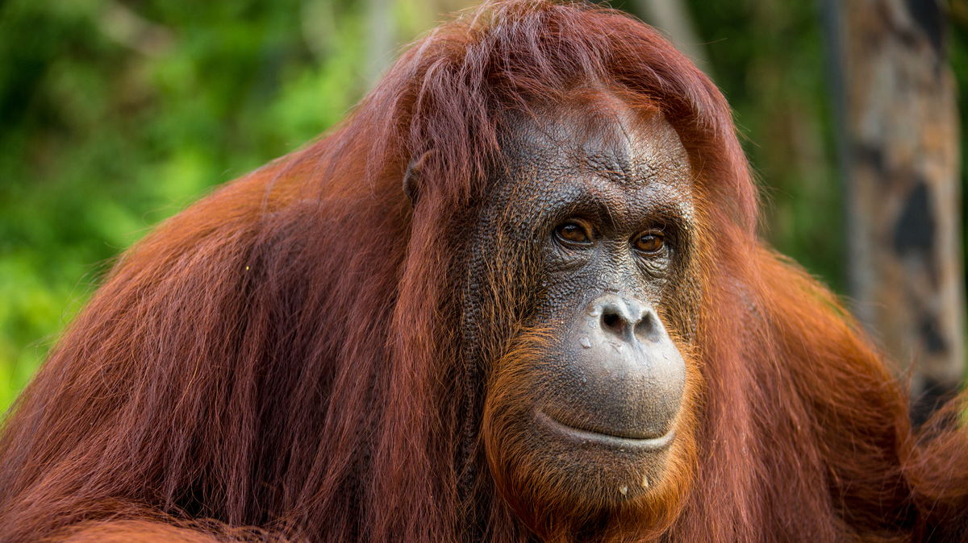
The Orangutan
BY MAIA MCGAUGHEY

Slide 2
features
There are three different types of orangutans; these are the Bornean orangutan, the Sumatran orangutan and the Tapanuli orangutan which was only discovered in 2017. The orangutan are the only living species of the subfamily ponginae. Orangutans were found in the rainforest of Borneo and Sumatra but now they are also found in Southeast Asia and South China.
Orangutans have bright orange fur, long arms and quite short legs with feet that look like hands. The lifespan of the Borneo orangutan is usually 35 – 45 years, the Sumatra orangutan weighs around 45 kilograms and has a height of 1.4 metres where the Borneo orangutan has a weight between 50 – 100 kilograms and a height between 1.2 – 1.4 metres. The orangutans scientific name is pongo.

Slide 3
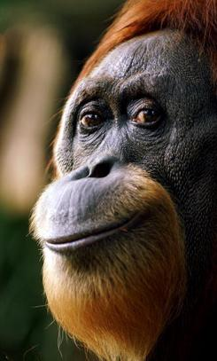
Famous orangutans
In the Discworld novels author Terry Pratchett famously created one of his main characters as an orangutan. The librarian was a wizard who was involved in a magical accident which turned him into an orangutan. Discovering the advantages of his new body he refused to be turned back again.
Ah Meng was a Sumatran orangutan and was considered the world’s most famous orangutan. She met many famous people such as Prince Philip, Elizabeth Taylor, Bjorn Borg, Michael Jackson and Steve Irwin. She received an award as Special Tourism Ambassador for Singapore where she lived in the zoo with her 5 children and 6 grandchildren. She starred in over 30 films earning an hourly fee of over £1000. The zoo held a memorial service for her when she died in 2008 at the age of 48.

Slide 4
deforestation
Animals all around the world, including orangutans, are suffering from deforestation, especially in Borneo. Orangutans just like these ones are losing their homes due to deforestation. Without homes they have no shelter, and this puts them more at risk from predators around them.
Deforestation is also being blamed for pandemics such as COVID-19; by driving animals from their homes and forcing them into closer contact with humans, there is an increased risk of animal-to-human disease spread.

Slide 5
Fun facts
Humans share nearly 97% of orangutan DNA
Their diet consists mostly of fruit and leaves
Female orangutans give birth around once every eight years
Orangutans don’t like to live in groups, a female orangutan may carry one or two babies, but a male will prefer to be alone
Orangutans are on the endangered list
The word orangutan comes from the language Malay and means person of forest
Nonja, a Sumatran orangutan, died at the age of 55 years in December 2007; she was thought to be the oldest-living orangutan of her species
Male orangutans can have an arm span of 2 metres
Orangutans use branches and leaves as an umbrella to shelter themselves from sun and rain

Slide 6
